Slide 1

Team Squadron (Well Organized Team)
Kaggle Santander Customer Transaction Prediction Competition
Mohammadreza Iman, second year CS PhD student
Denish Khetan, MS AI student
Data science practicum, CSCI 8360, Spring 2019

Slide 2
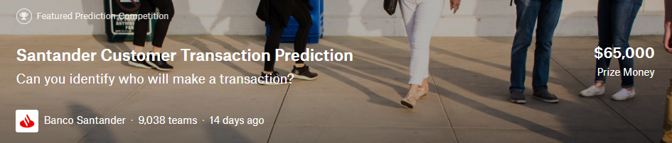
About the challenge
Based on the given customer transaction data by Santander Bank, identify which customers will make a specific transaction in the future, irrespective of the amount of money transacted.
Dataset
Dataset: Anonymized dataset containing numeric feature variables, the binary target column (classification)
Training dataset: 200,000 samples consist of 200 features and the target
Test dataset: 200,000 instances consist of same 200 features of the training set

Slide 3
Challenges with Dataset
No details about the features, only numerical data (tabular data)
Binary classification (zero/one)
 | Target | abs corr
var_81 | -0.08092 | 0.080917
var_139 | -0.07408 | 0.07408
var_12 | -0.06949 | 0.069489
var_6 | 0.066731 | 0.066731
var_110 | 0.064275 | 0.064275
var_146 | -0.06364 | 0.063644
var_53 | 0.063399 | 0.063399
var_26 | 0.062422 | 0.062422
var_76 | -0.06192 | 0.061917
var_174 | -0.06167 | 0.061669
var_22 | 0.060558 | 0.060558
var_21 | -0.05848 | 0.058483
var_99 | 0.058367 | 0.058367
var_166 | -0.05777 | 0.057773
var_80 | -0.05761 | 0.057609
var_190 | 0.055973 | 0.055973
Statistics
No correlation between data, the highest absolute correlation: 0.08
200 features
Unbalanced training set, less than 15% class 1

Slide 4
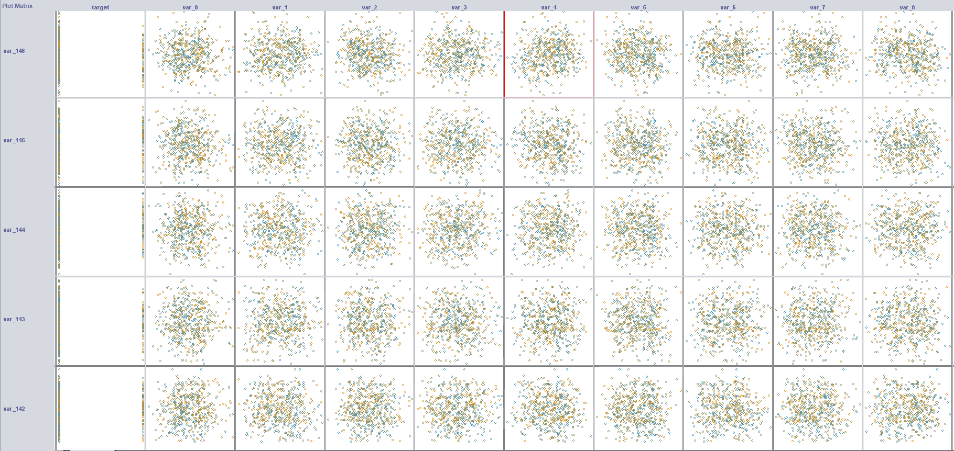
Train data visualization

Slide 5
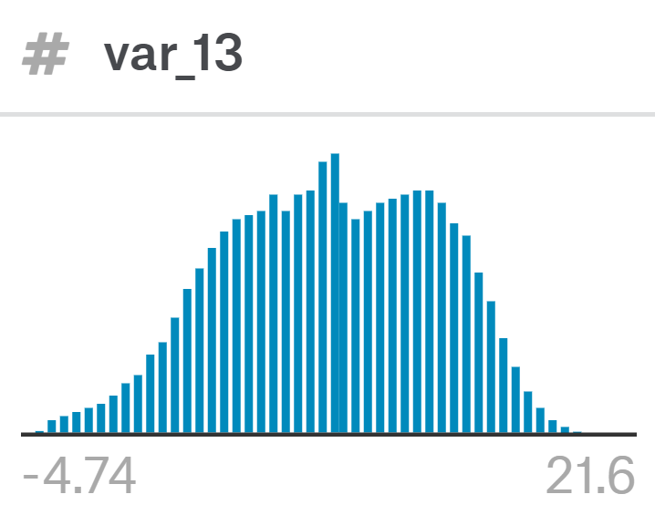
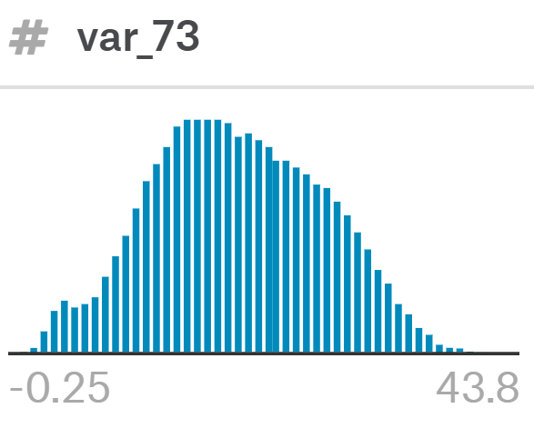
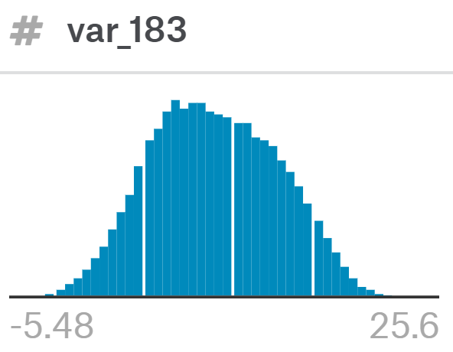
Preprocessing
Outliers: if (abs(z-score) > 3) => removed ≃12000
Standard error of the mean
A z-score of 3 is 3 standard deviation above the mean
Clean data (no need of imputation)
Normalization
Scaling
Feature Selection:
Using Recursive Feature Elimination (RFE) method by Logistic Regression (150 feature been selected with rank 1)
Using random forest model and feature importance method (73 features)
Based on the high rank of correlation to the target (27 features)

Slide 6
Evaluation
AUROC (Area Under the Receiver Operating Characteristics) as a measurement for accuracy
The Area under the Receiver Operating Characteristic is a common summary statistic for the goodness of a predictor in a binary classification task.
The true positive rate (Sensitivity) is plotted in function of the false positive rate (100-Specificity) for different cut-off points.
Confusion Matrix
For a better comparison between methods

Slide 7
Approaches
Trees & Random Forest
Clusterings
Sum-Product Networks
Neural Net & Deep Learning

Slide 8
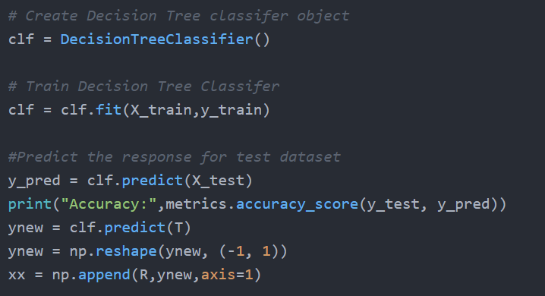
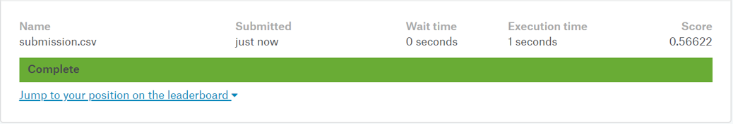
Trees & Random Forest
Decision Tree
Best Accuracy so far on training set: 0.8396 On test set (Kaggle): 0.5662
(test size 0.15, random_state: 1)

Slide 9
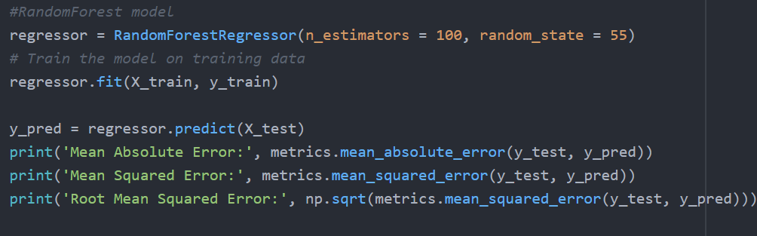
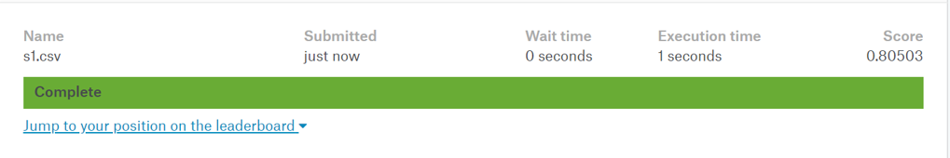
Trees & Random Forest
Random Forest
Best Accuracy so far on training set: 0.7241 On test set (Kaggle): 0.8050

Slide 10
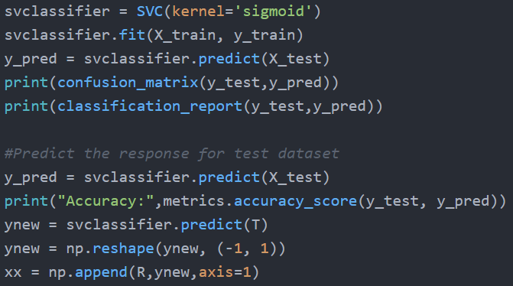
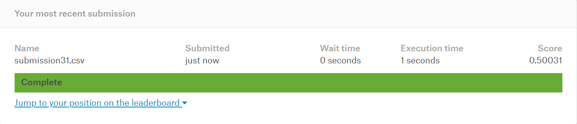
Clusterings
Support Vector Machine(SVM):
Best Accuracy so far on training set: 0.9005 On test set (Kaggle): 0.5003
Poly: 0.5000, Sigmoid: 0.5003, Gaussian: 0.5539

Slide 11
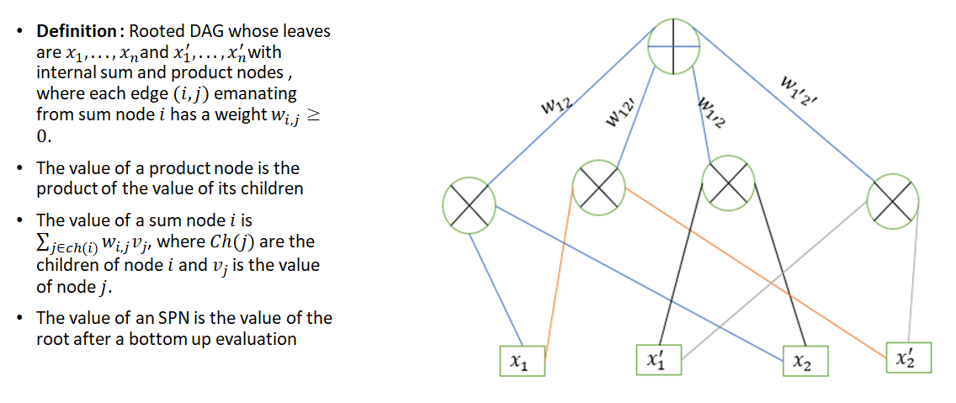
Sum-Product Networks
https://github.com/arranger1044/awesome-spn
Notes:
http://alchemy.cs.washington.edu/spn/poon11.pdf

Slide 12
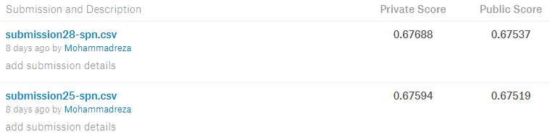
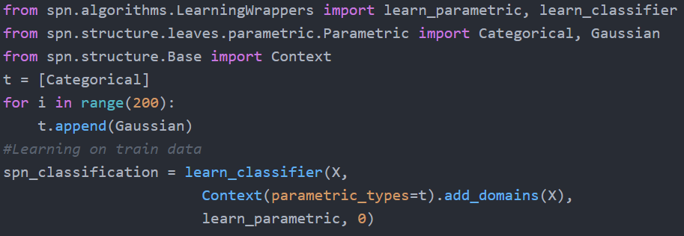
Sum-Product Networks
https://github.com/SPFlow/SPFlow

Slide 13
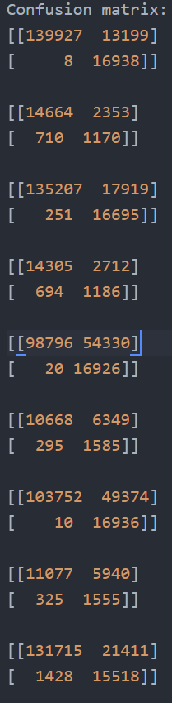
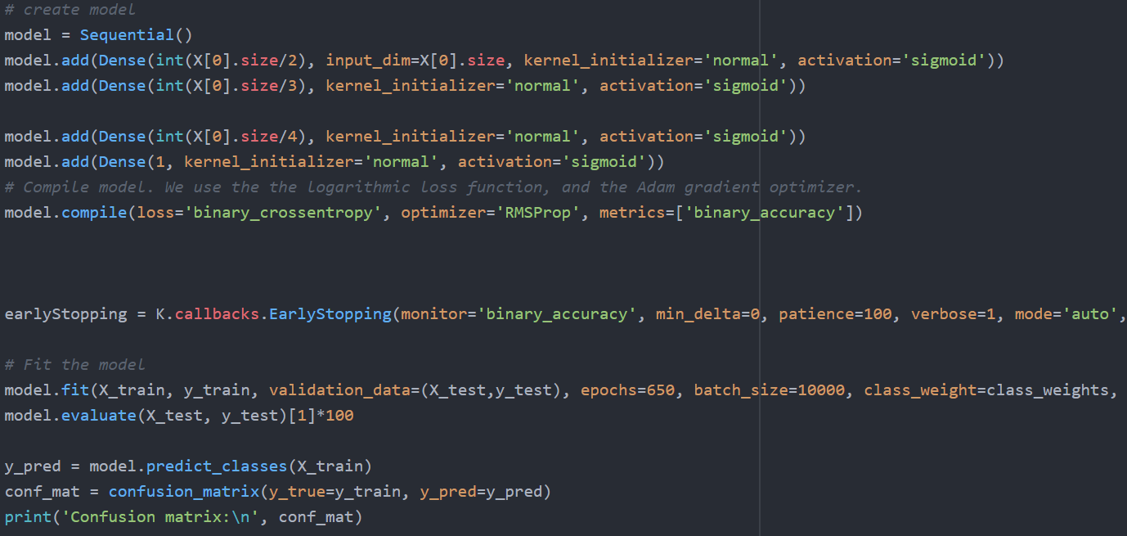

Neural Net & Deep Learning

Slide 14
Currently working on / Future Enhancements
Readme
Wiki
Paper
Ethics Policy Checklist
Improving applied models
K-Nearest Neighbor (KNN)

Slide 15
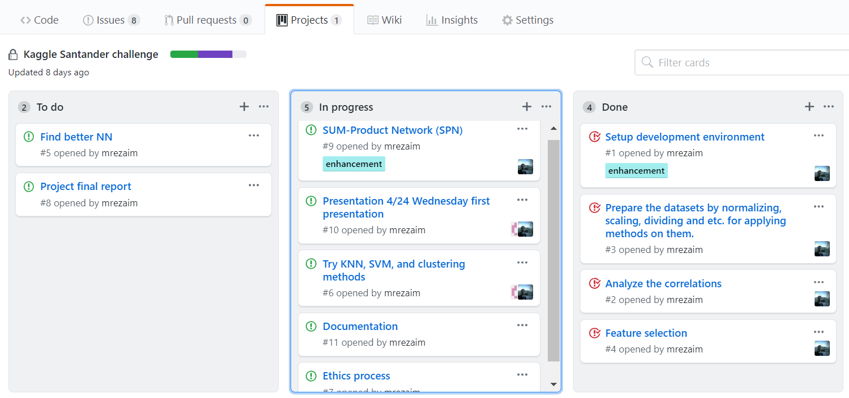
Current status of the project

Slide 16
Thanks
Q&A

